Slide 1
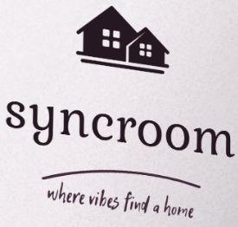


SyncRoom – “Where vibes find a home.”
TEAM NAME – 11:11
TEAM MEMBERS
NIKHIL TIWARI (Mgt. + Presentation)
AYUSH RANAKOTI (Backend + Frontend (basics))
SIMRAN MAKAN (Backend + Frontend + Firebase)
HANSUJA ARYA (Presentation + Designing)
RIDHIMA (Presentation + Designing)

Slide 2


PROBLEM STATEMENT
Finding the right accommodation—be it a rental property, hotel room, or roommate—is often stressful and unorganized.
Users face issues like : Switching between multiple apps for rentals, hotels, and room mates.
Trust and safety concerns with strangers and unverified listings.
Lack of transparency in pricing and availability.
There is no single reliable platform that unifies all these services while ensuring security, trust, and real-time availability.

Slide 3
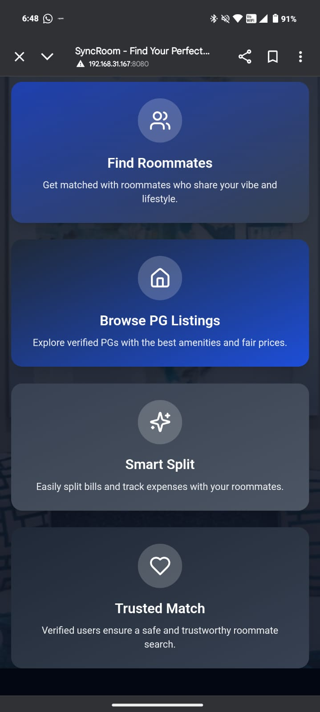
Solution : SyncRoom
SyncRoom is a one-stop lifestyle platform that makes finding and booking rental properties, hotel rooms, and roommates simple and secure.
It stands out by focusing on lifestyle needs, not just accommodation.
Key Highlights:
All-in-one platform for rentals, hotels, and roommate search.
Verified listings ensuring trust and safety.
Real-time availability for faster bookings.
Vibe matching to connect users with compatible roommates.
Lifestyle-driven approach, offering personalized suggestions to fit users’ living
preferences.
With SyncRoom, users can save time, avoid stress, and create a comfortable living experience — all in one place..

Slide 4

Our Mission & Vision
MISSION
To simplify and enhance modern living by providing a
secure, all-in-one lifestyle platform that connects
users with trusted rentals, hotels, and roommates, ensuring
comfort, transparency, and convenience in every stay.
VISSION
To become the go-to lifestyle platform for anyone seeking accommodation
— creating a global community where finding the right space and people
is effortless, reliable, and stress-free

Slide 5
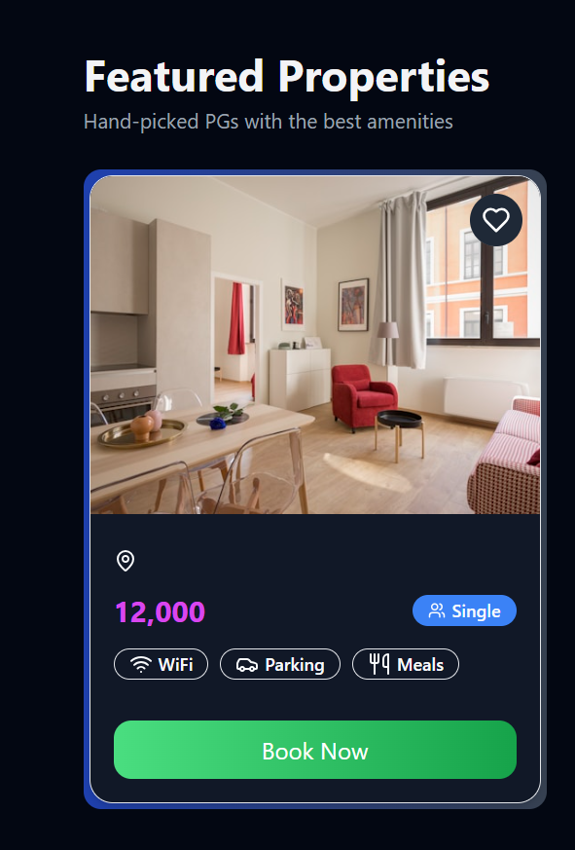
TECHNOLOGY STACK
Backend & Database
Frontend Development
Firebase for scalable server architecture
React Native for cross-platform mobile apps
Python for machine learning /AI algorithms
HTML5, CSS3, JavaScript for web interface
Firestore for data management
Responsive design principles

Slide 6
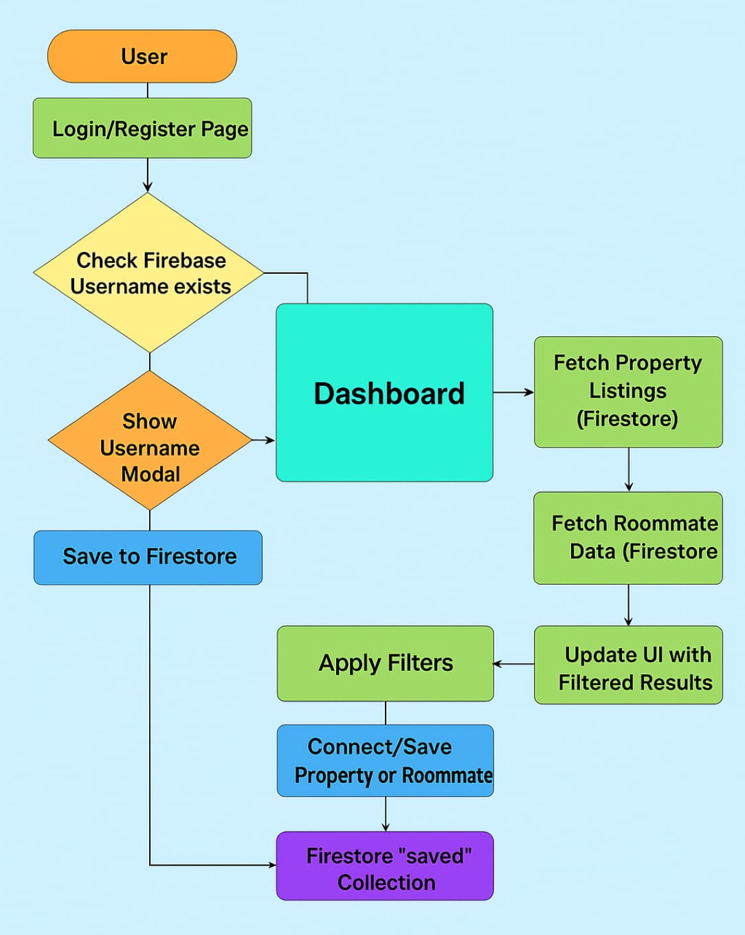
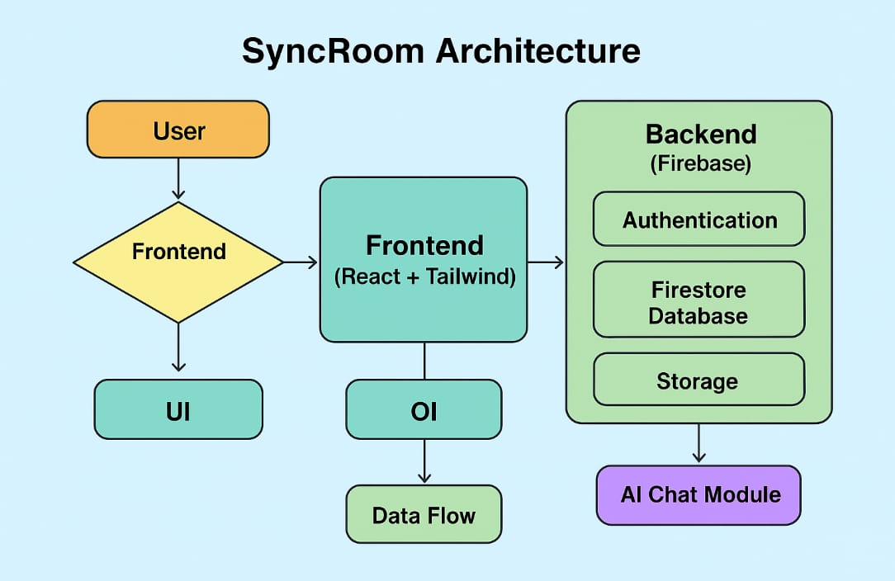
SYSTEM WORKFLOW AND ARCHITECTURE

Slide 7
Key features and innovation
Key features :
Innovations:
User Authentication – Secure login & registration using Firebase Auth.
Property Listings – Browse and filter rental properties by location & amenities.
Roommate Matching – Find compatible roommates based on preferences.Save & Connect – Bookmark favorite properties and roommates.
Real-time Updates – Instant data sync with Firebase Firestore.Responsive UI – Clean, modern design with React + Tailwind.
Username Prompt Flow – Captures username dynamically at first login.
Serverless Architecture – Entire backend powered by Firebase (scalable & low-maintenance).
Dynamic Filtering – Real-time search and filter without page reload.
Seamless Integration – Unified platform for both properties and roommate search.
Future Ready – Expandable for chat, payments, and AI-based roommate matching.

Slide 8

Implementation plan
Research & Planning – Understand user needs, finalize tech stack.
MVP Development – Build core lifestyle features: listings, roommate matching, secure login.
Testing & Refinement – Fix bugs, improve UI/UX, ensure privacy.
Demo Preparation – Create working prototype and finalize hackathon demo.

Slide 9
Challenges and risk mgt.
Data Security: Use Firebase Auth & Firestore rules to protect user data.
Scalability Issues: Optimize queries and use Firebase’s serverless scaling.
User Authentication Errors: Validate inputs and handle failed logins gracefully.
Performance Lag: Implement efficient state management and lazy loading.
Data Loss Risk: Enable Firestore backups and recovery plans.

Slide 10
Impact and conclusion
Impact: Simplifies roommate search and property finding with real-time, secure data.
User Benefit: Saves time, ensures safety, and enhances user experience.
Scalability: Ready for future features like chat, Razorpay Payment.. And Global Expansion.
Conclusion: SyncRoom is a modern, reliable solution for hassle-free roommate and rental management.

